Slide 1

Time to meet your favourite person!
Submitted as a project for completion of Internship at Exposys Data Labs

Slide 2
Team Introduction:
Mohamed Aweez Akram (1HK17CS079) – aweezakram1999@gmail.com
HKBK College of Engineering, Bangalore - 45
Naveen N (1HK17CS100) – nikhil.naveen.333@gmail.com
HKBK College of Engineering, Bangalore - 45
Mohammed Adnan K (1HK17CS085) – mdadnan12375@gmail.com
HKBK College of Engineering, Bangalore - 45
Nithish Kumar R (1HK17CS107) – nkawaits@gmail.com
HKBK College of Engineering, Bangalore - 45

Slide 3
Project Introduction:
A video chat website is a platform that allows you to interact in live with people, which is our primary inspiration for this project.
The goal of our project is to enable our users to have exclusive conversation with another user either through the chat box or join real-time streaming video chat rooms where users can share their video with one another.
Users can directly enter webcam chat rooms after signing up. Also this website doesn’t require any additional installation on the client side. By just accessing our website, users can have a video connection from both the ends.
The main technology used in this project is the Django Framework. Django is a python framework used for the development and deployment of cross platform, rich Internet websites based on existing web technologies.

Slide 4
Existing Methodology:
Most of the existing famous methodologies are developed as a software application. Unlike those methods, we have developed our project as a complete website so that the user can access it through any web browser.
Most of the communication today happens through e-mails or chat applications. Our website ensures that users can have communication with each other through live one-on-one interaction along with sharing of data.
The technology implemented here is WebRTC or Web Real-Time Communication which delivers an efficient way of communication through video/voice call enabled chat API and provides the ability to deliver high pixel-rate audio and video chats.
The protocol used in developing this website is the one of the most important and widely used HTTP/HTTPS protocol. We also use SIP, which is a signaling protocol used by VoIP and video conferencing systems.
To enable communication between a WebRTC website and a SIP client such as a video conferencing system, WebRTC needs a proxy server to mediate signaling.

Slide 5
Methodology Used:
Approach: The website is developed using one of the most popular Web Framework known as Django.
The project makes use of GUI through which the user can interact with the website and use its features.
Here’s how it works –
The GUI operates in the form of a chat box along with the video display of the user.
When the user gives permission for the camera and microphone, they can start searching for the desired user in the list.
The list will contain all the users who are online.
The user can select any online user for initiating the communication and if the receiver accepts the request, they can start communicating with each other.
When either of the users wants to end the communication they can press the ‘end call’ button.

Slide 6
Functional Requirements:
The primary requirement of a video chatting website is to provide a mechanism for virtual online face-to-face communication on a small scale.
Non-Functional Requirements:
Hardware Requirements -
Operating System: Windows family, MAC OS, Linux, etc.
Browser: Chrome, Firefox, Opera, Brave, etc.
RAM: Minimum 2 GB.
Processor: Intel Core (1.90 GHz)
Software Requirements -
Languages used: HTML, Javascript, CSS, Python
FrontEnd: Django Framework, Bootstrap 4
BackEnd: SQLite
Technology: PeerJS

Slide 7
Implementation:
Connecting to the server – ( The code connects the client to the server )
function startPeerClient(username) {
// TODO - Set title
cookie.set('username', username);
peerClient.connectToServerWithId(username);
}
Users online – ( The code updates online users list every 5 seconds )
updateOnlineUsers : function (users) {
var list = $('.onlinepeers')
list.empty()
if(users.length == 0) {
var usr = '<li>Looks like no one is online</li>'
list.append(usr);
return }
for (var i = 0; i < users.length; i++) {
var usr = '<li class="peeruser">'+ users[i] + '</li>'
list.append(usr); }
}

Slide 8
Video call – (The code enables streaming video from user side and client side )
setTheirVideo : function (stream) {
var video = document.getElementById('their-video');
if (typeof video.srcObject == "object") {
video.srcObject = stream; }
else {
video.src = URL.createObjectURL(stream);
}
}
setMyVideo : function (stream) {
// $('#my-video').prop('src', stream);
var video = document.getElementById('my-video’);
if (typeof video.srcObject == "object") {
video.srcObject = stream; }
else {
video.src = URL.createObjectURL(stream);
}
}

Slide 9
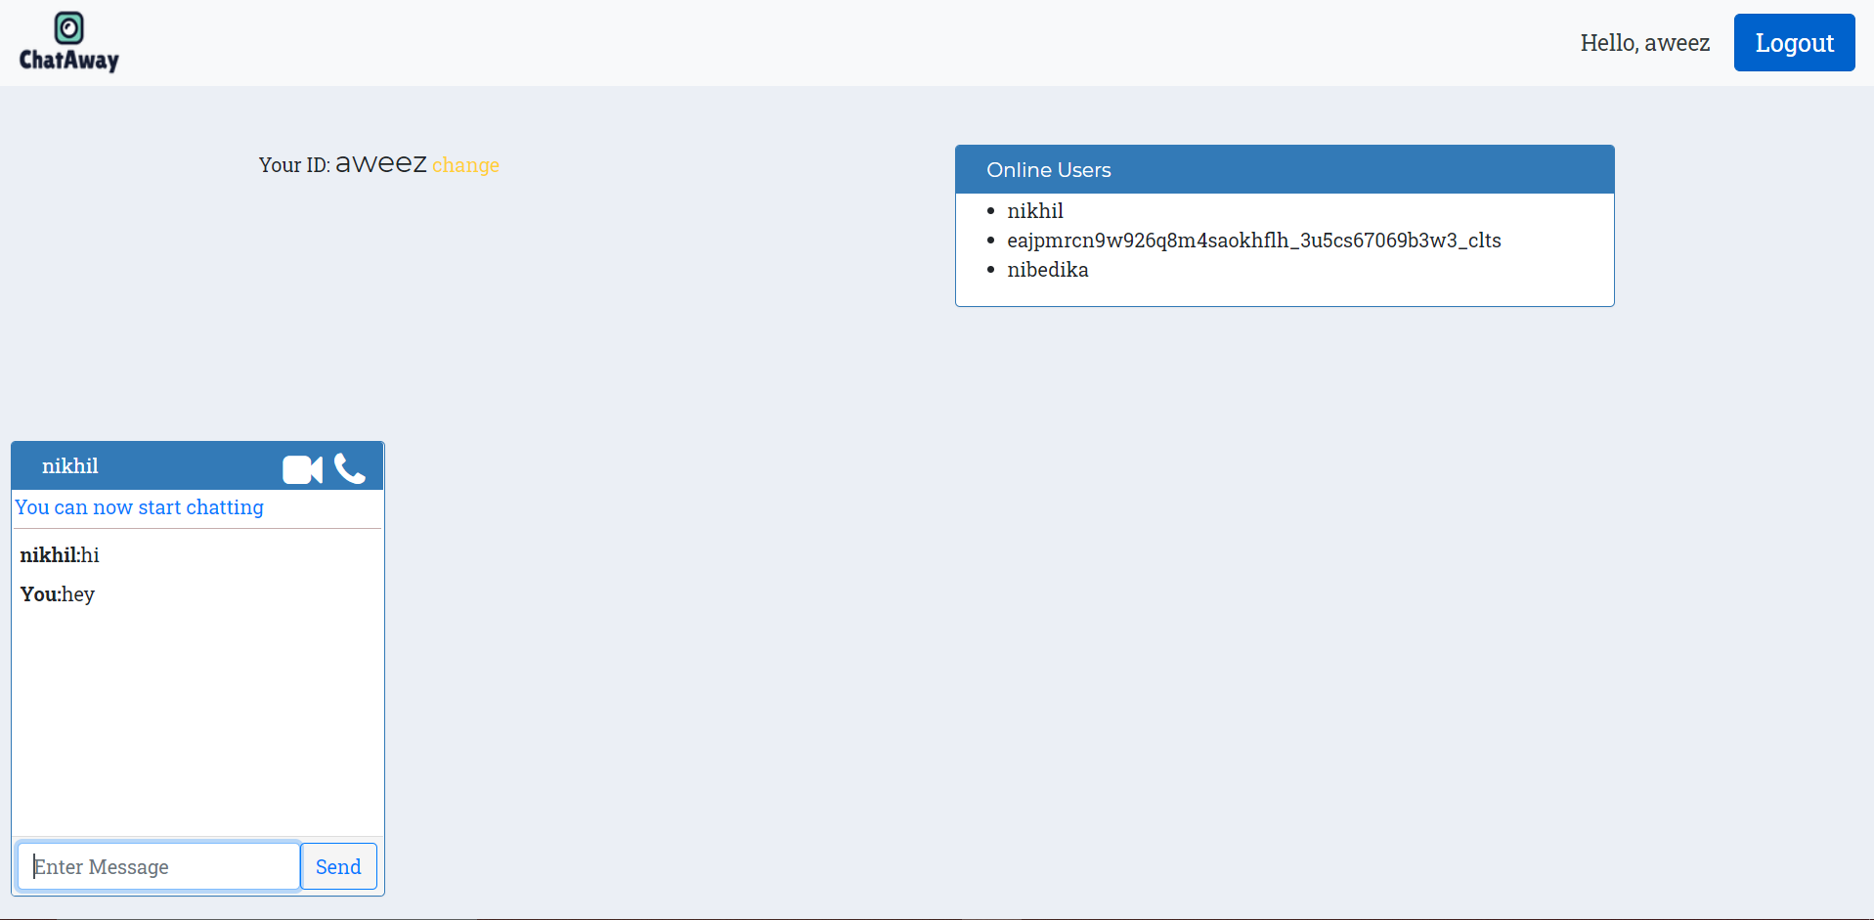
Snapshots:
Chat Room -

Slide 10
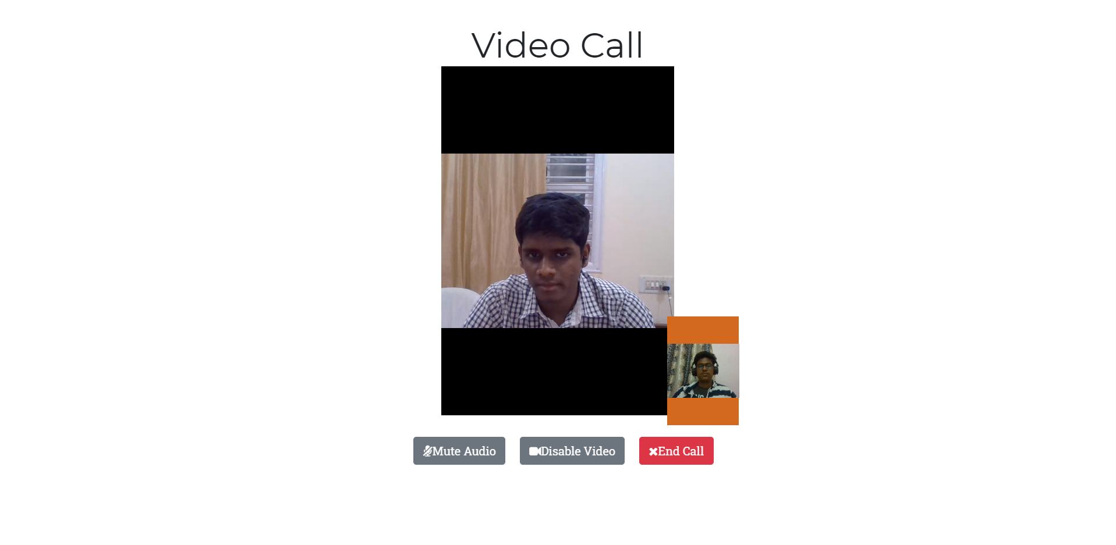
Video Call –

Slide 11
Conclusion:
The website developed for video chatting has been implemented according to the latest technology and requirements.
The website requires valid credentials from the user for authorization and verification purposes so that user can register and login to their account for initiating the communication.
The website is developed and implemented using WebRTC which is the latest among technologies for communication through mobile applications and web browsers.
Hence, we would like to conclude that any user who wants to make a video call instantly can make use of our website.

Slide 12
THANK YOU!

